Slide 1
Pic2Kitchen
AI-powered food app with advanced photo recognition
and recipe recommendation system
Notes:
Have you asked yourself what would you do if you have canned tomatoes at hand? Well, all you have to do is to install Pic2kitchen.

Slide 2
1
2
Dataset
3
Usage
Motivation
4
Demo
5
Workflow
6
Future works

Slide 3
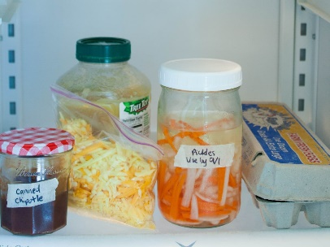

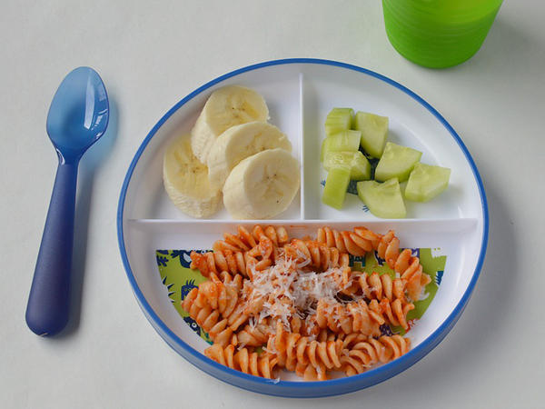
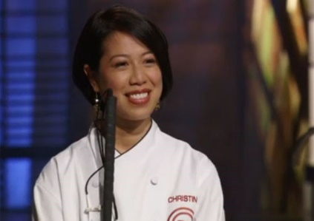
Motivation
Consume all the leftover ingredients in fridge
No idea what to do with discounted products at supermarket
Cook different foods with unique recipes
Cook like a truly chef

Slide 4
Dataset
Object recognition
Recipe recommendation
`
Google Image V6
Scraping image
Yummly 28k
18 classes:
Bread, mushroom, cucumber, radish, Potato, Tomato, Oyster, Crab, Seafood, Egg, Salad, Squid, Shrimp, Shrimp, Carrot, Cabbage, Pumpkin, Tomato.
5 classes:
Pork, Beef, Chicken, Salmon, Tuna.
27638 Recipes

Slide 5
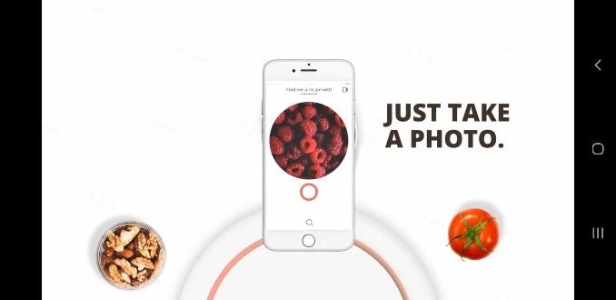
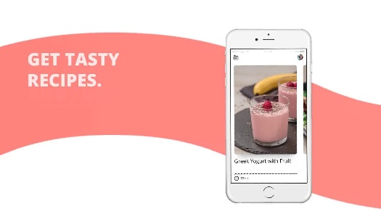
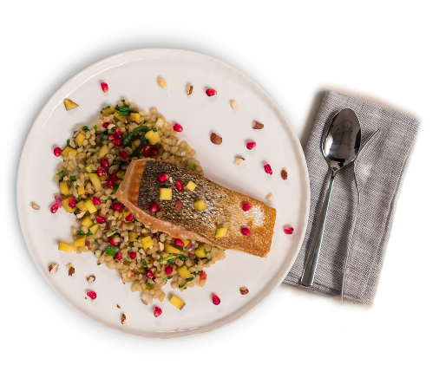
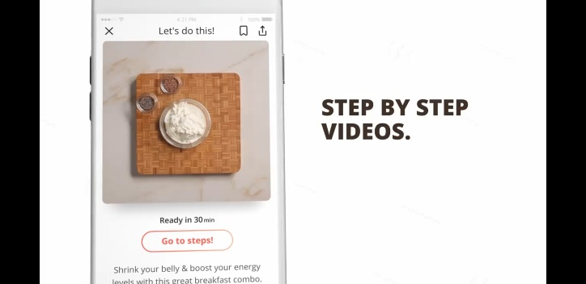
How to use ?
Take a photo of the ingredient.
Pic2kitchen will suggest the tasty recipe
Pic2
Kitchen
Step by step videos to
instruct you how to cook
The meal is ready to be served
Notes:
https://www.engadget.com/2018-09-11-pixfood-app-googles-recipes-jian-yang-ripoff.html
Pic2kitchen is AI-driven food app with advanced photo recognition. The user experience is quite simple: it all starts with users taking a photo of any ingredient they would like to cook with, in the kitchen or in the supermarket. Why did we do it like this? Because it’s personalized. After you take a photo, the app instantly sends you tailored recipe suggestions! At first, they are more or less the same for everyone, but as you continue using it, it starts to learn what you precisely like, by connecting patterns and taking into consideration different behaviors
Imagine: You're trying to make do with whatever's left in your fridge or you've just found a choice (or cheap) cut of meat at the grocery store. You could just Google the ingredient(s) and see what recipes pop up, but that's low-tech thinking for simpler minds. Why not harness the power of machine learning, AI and other buzzwordy tech to do it for you? The new app PixFood promises to do just that: It recognizes a photo of a single ingredient and suggests recipes with step-by-step instructions for your culinary adventures!
Or you could, y'know, Google it. As PixFood's tech stands now, it's a step up from just recognizing whether or not something's a hot dog. Once you take a photo of an ingredient with the app, you'll have to confirm what kind of food it is from a few suggestions -- which sounds a lot like every user helping train its machine learning tech for accuracy -- and then sift through a handful of recipes, some of which are dimly related (it suggested nicoise with tuna steak from my chosen ingredient, beef steak).
Admittedly, the recipe presentation is clean and no-fuss, with nice video clip demonstrations. But the tech is pretty basic for 2018. Do you really need something slower than a Google search? And a service that, for now, only suggests meals from one ingredient at a time? If you're looking for a more modern look than the Food Network website, PixFood might be your bag. I'm still waiting for an app that gives me something to do with all the leftover junk in my fridge so I can put off going out for groceries.

Slide 6
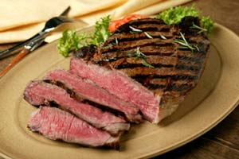
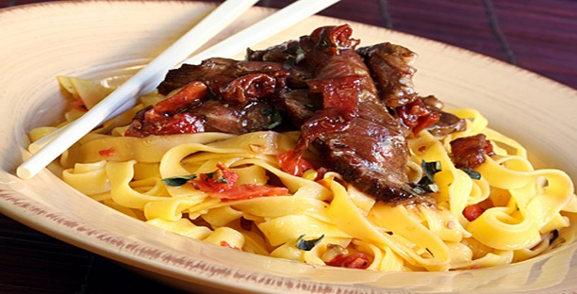
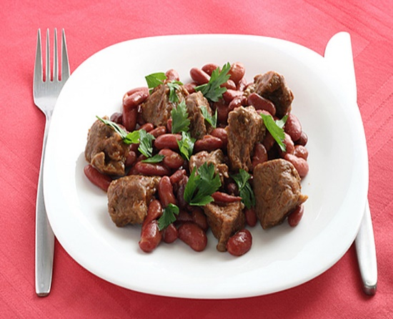
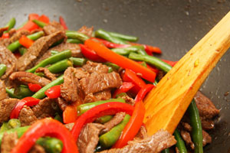
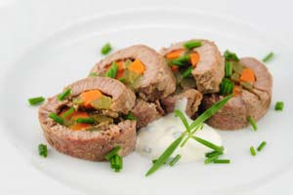
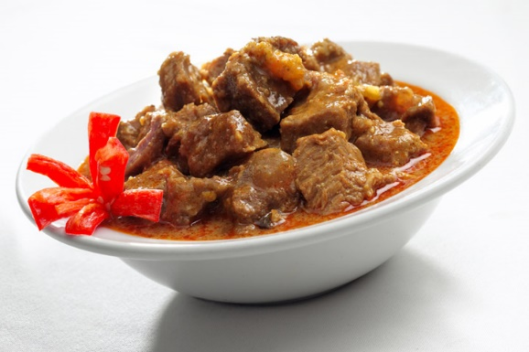
Pic2Kitchen will suggest you 6 things to make with BEEF.
Beef
Steak
Stir-Fried beef
Beef And Beans
Curry Beef
Beef Roll
Notes:
https://www.foodnetwork.com/recipes/photos/things-to-make-with-canned-tomatoes

Slide 7
DEMO

Slide 8
WORKFLOW

Slide 9
Workflow Chart
NEW USER
Google Image V6 dataset
YOLO V3 Darknet
SQL
Query
Top 6 similarity
Save
user data
Content base - recommend
Scrape data
Normalized
data
Yummly recipe Dataset
Feature vector from Yummly
Doc2Vec
OLD USER
Ingredient recognition
Recipe recommendation system

Slide 10
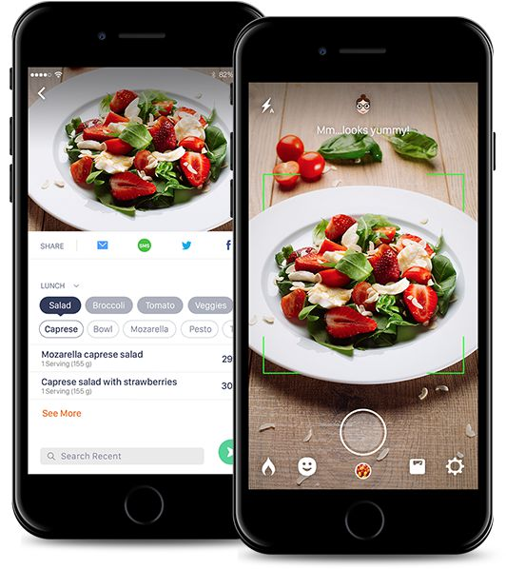
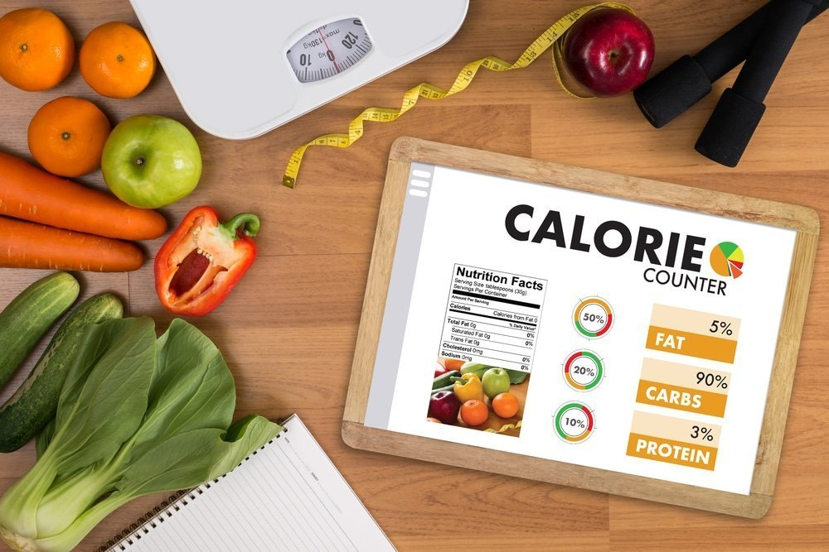
Future works
Calories counter
Public on Android/IOS
Notes:
https://www.yummly.com/meal-planning/ideas

Slide 11
Thank you!

